Slide 1
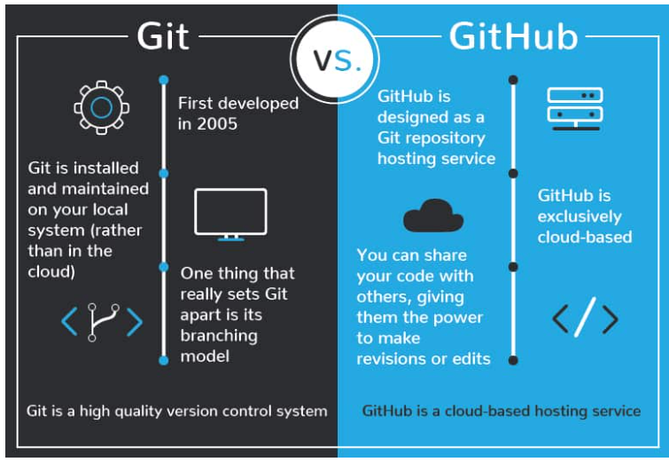
Git Vs Github Name: WeeChong Tan Date: May2023

Slide 2
Agenda
Git vs GitHub
Data Flow
Get start with GIT
Create a Repository
Create a Branch
Make a Commit
Open and Merge Pull Request
Github Case Study

Slide 3
What is Git vs GitHub ?
GIT - Software Tool to host Repository in the local machine
GITHub - Service to host Wed-based Repository in the cloud.
GIT
Version control System
Historical Backup
Team Development
Command Line instruction
Trunk- Based Development

Slide 4
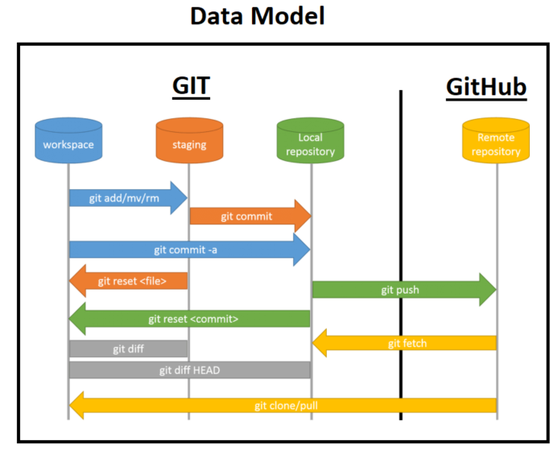
GIT Data Flow (Commmand Line Prompt)
Primarily Consists of :
Workspace
Staging
Local Repository
Remote Repository

Slide 5
GIT Data Flow – Upload changes to GitHub
Workspace – The working directory storing all the files on Local machine or Laptop. Add files to Staging.
Staging – Select the files to be added to the local depository
Local Repository – Ready to push all the latest updated changes to the Remote Repository or GitHub
Remote Repository – Github storage is in sync with the Local Depository or Workspace

Slide 6
GIT Data Flow – Sync GitHub to workspace
Remote Repository – Github storage is pull to Local Repository
Remote Repository – Github storage is Clone to Workspace

Slide 7
What are the software needed to support GIT/Github?
Install Git on Windows - https://git-scm.com/download/win
Sign up Github storage
Command Prompt / PowerShell / GIT Bash (Unix user)
GitHub Desktop
VS coder editor

Slide 8
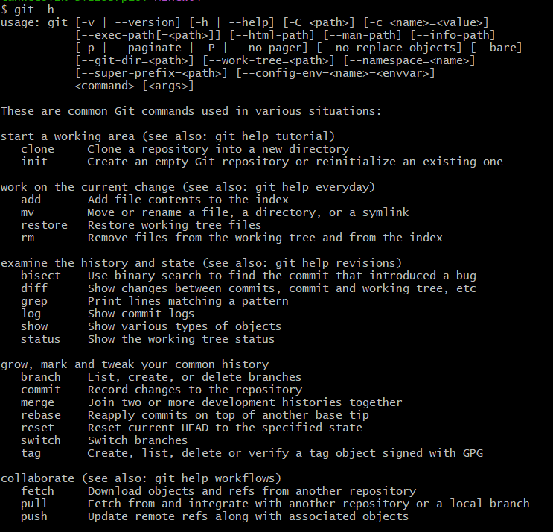
Git help – Command Prompt

Slide 9
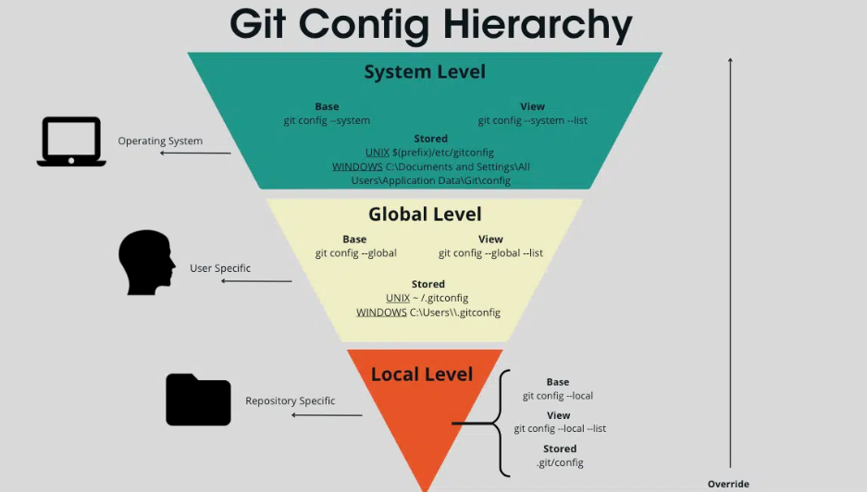
GIT Config

Slide 10
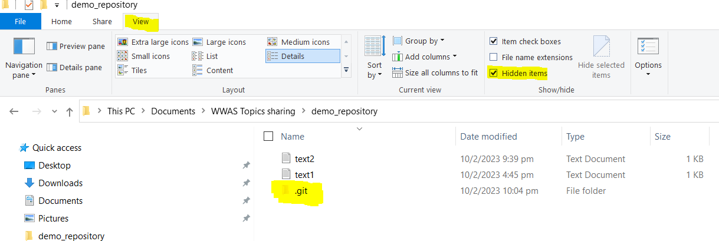
Hidden Local repository config

Slide 11
Case1: Repository Push from Local Repo to GITHub
Clone a local repository in local machines:
Perform a clone command to clone the repository to local machine (Workspace)
Git Add command to add updated files to the staging domain
Git Commit command to upload all the files changes into the local repository
Git Push command to push all the local changes in the local Repository to Remote Repository.
Command Prompt
Git clone
Git add filename.txt
Git commit –a –m “Message“
Git push

Slide 12
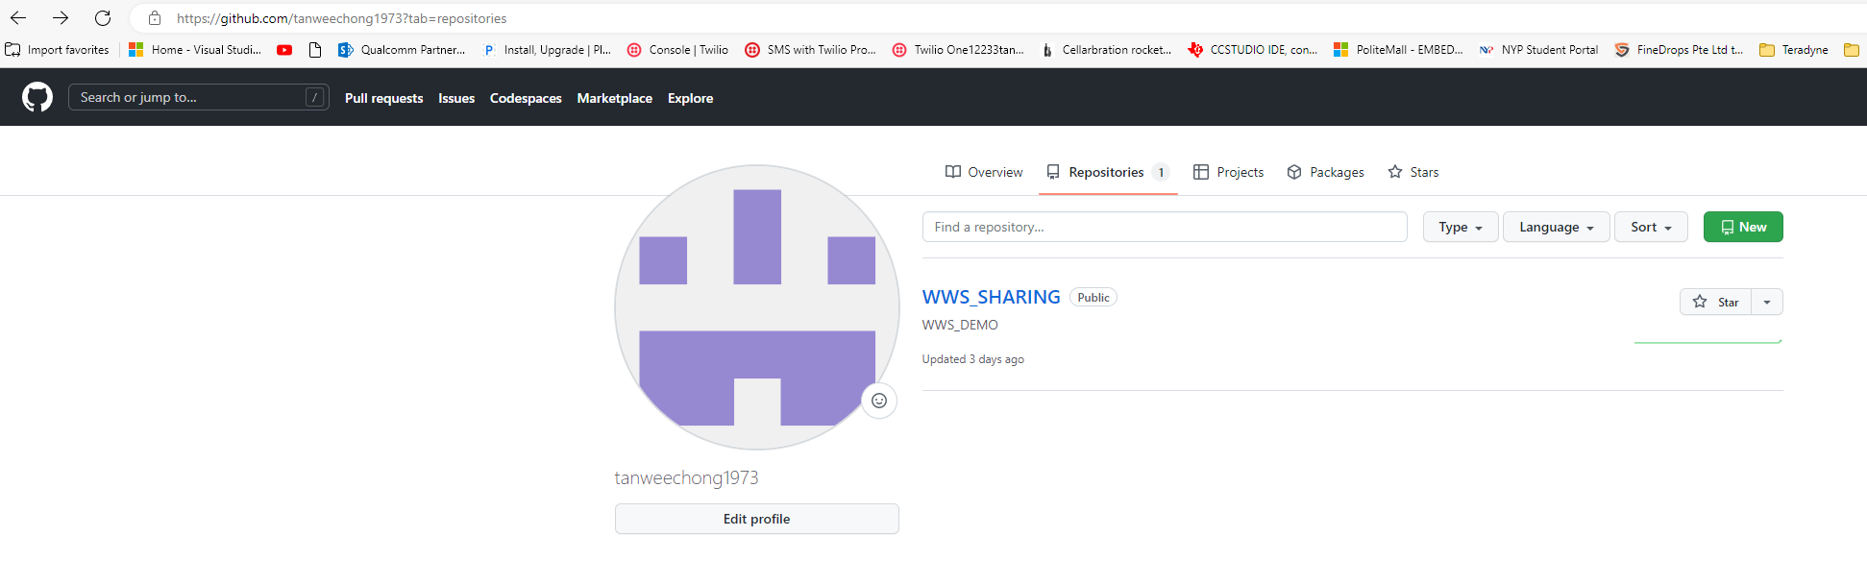
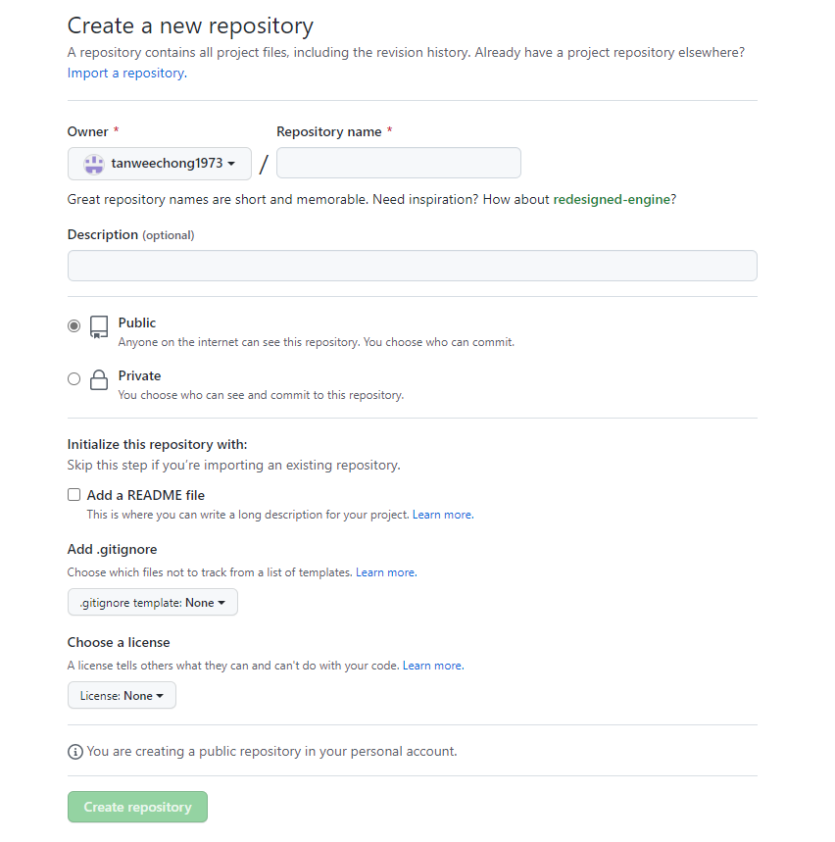
Github

Slide 13
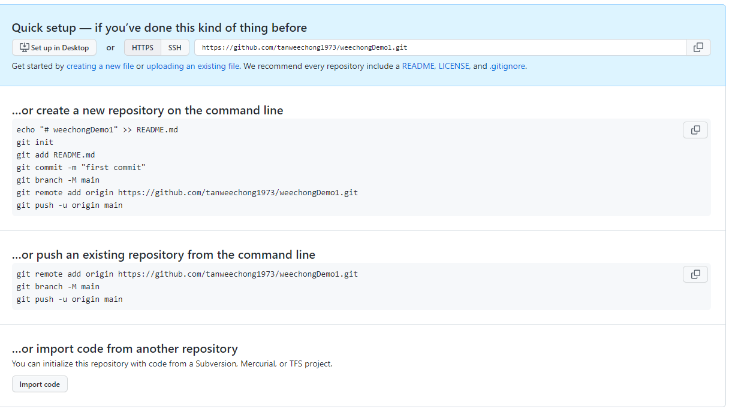

Slide 14
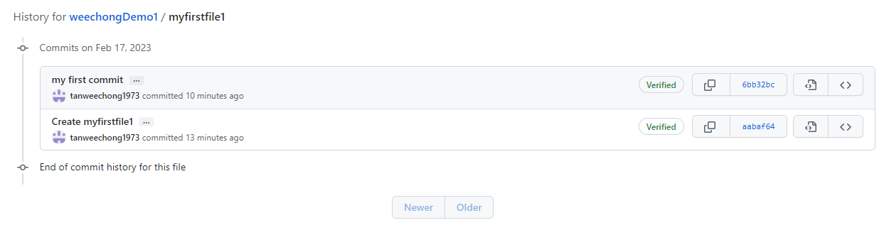
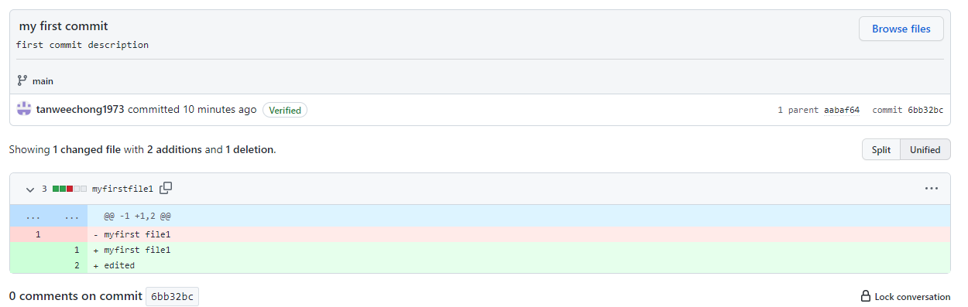
Repository History

Slide 15
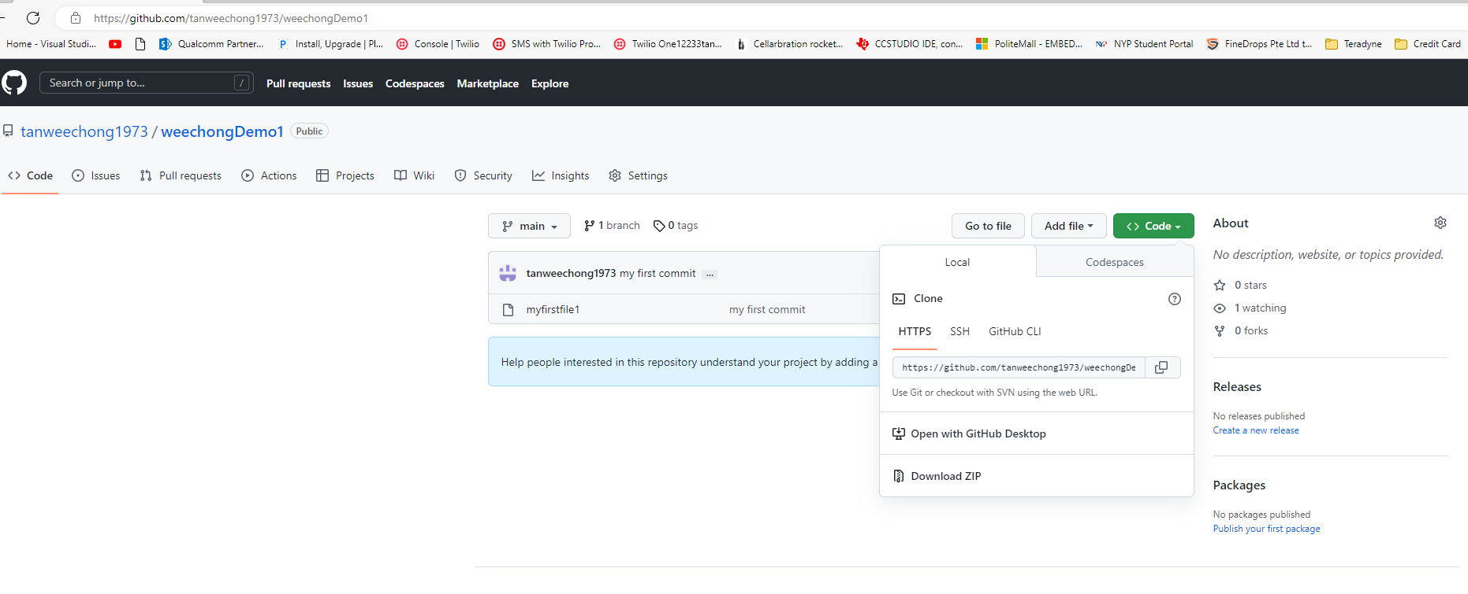
Github HTTPS

Slide 16
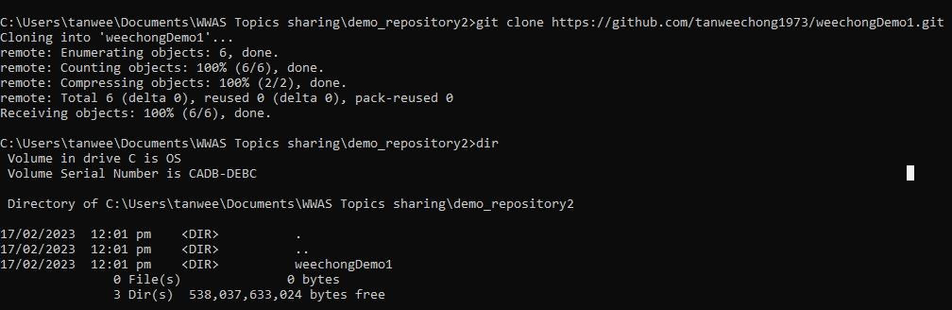
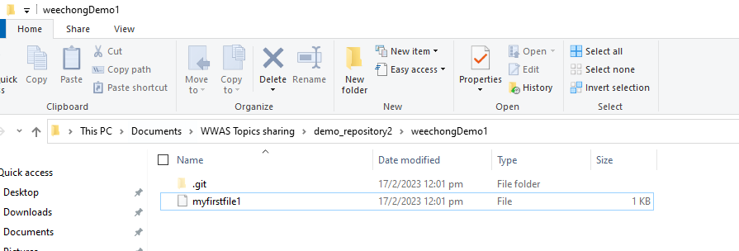
Clone Git URL to workspace

Slide 17
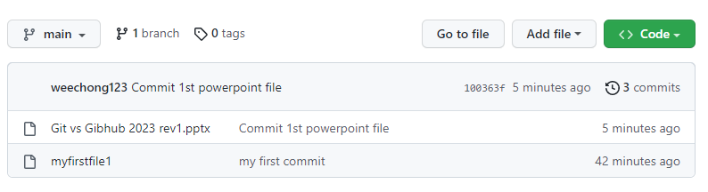
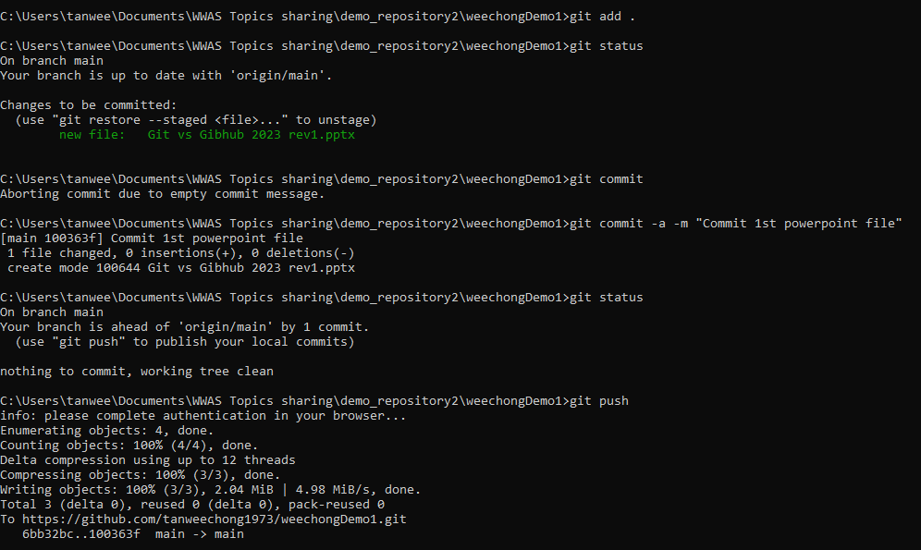
Push to Github

Slide 18
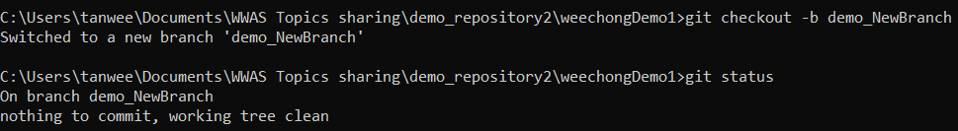
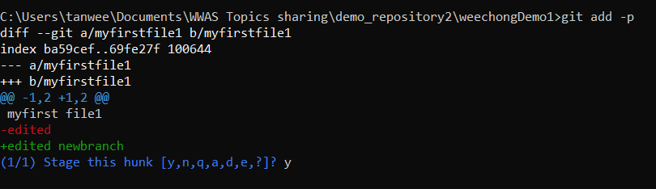
GIT Branch
git checkout -b demo_NewBranch
Create a New branch demo_NewBranch
Modified myfile1 add to new branch with command prompt -> git add –p

Slide 19
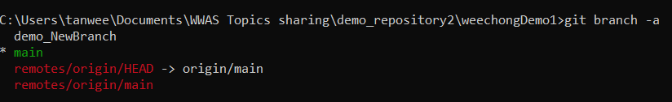

Git Branch
List both local and remote branches
Git branch –a
Current Status
Git status

